Slide 1
Network Layer Chapter 5
Design Issues
Routing Algorithms
Congestion Control
Quality of Service
Internetworking
Network Layer of the Internet

Slide 2
The Network Layer
Responsible for delivering packets between endpoints over multiple links
Application
Transport
Network
Link
Physical

Slide 3
Design Issues
Store-and-forward packet switching »
Connectionless service – datagrams »
Connection-oriented service – virtual circuits »
Comparison of virtual-circuits and datagrams »

Slide 4
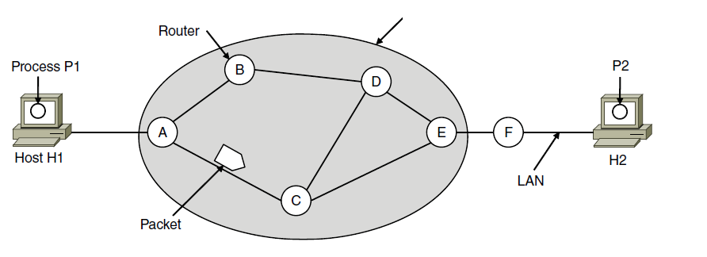
Store-and-Forward Packet Switching
Hosts send packets into the network; packets are forwarded by routers
ISP’s equipment
Packetizing：encapsulating the payload in a network-layer packet at the source
and decapsulating the payload from the network-layer packet at the destination.
Routing and forwarding
Notes:
Routers treat packets as messages, receiving (storing) them and then forwarding them based on how the message is addressed.
For completeness, it is a process running on the host that sends the packet into the network and receives packets at the destination.

Slide 5
Connectionless & connection-oriented service
Connectionless service
each packet is treated independently
the network layer is only responsible for delivery of packets from the source to the destination
the packets in a message may or may not travel the same path to their destination.
Connection-oriented service
Before all datagrams in a message can be sent, a virtual connection should be set up to define the path for the datagrams.
After connection setup, the datagrams can all follow the same path.
The packet contain the source and destination addresses, also a flow label, a virtual circuit identifier that defines the virtual path the packet should follow.

Slide 6
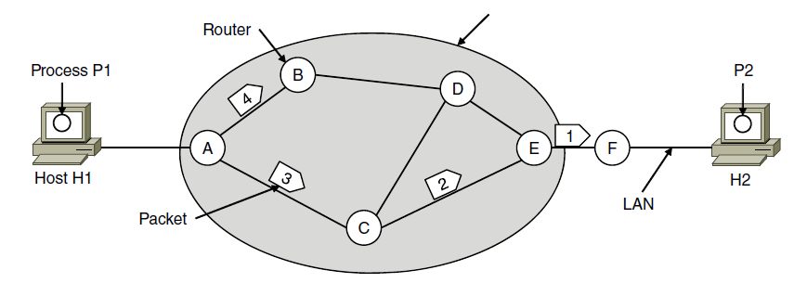
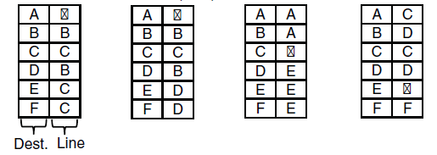
Connectionless Service – Datagrams
Packet is forwarded using destination address inside it
Different packets may take different paths
ISP’s equipment
A’s table (initially) A’s table (later) C’s Table E’s Table
Dest. Line
Notes:
This model is like the postal service – each letter is sent through the network independently.
Datagram is a packet that contains an absolute destination address; routers need only look up the destination address in a table to find the outgoing line to send the packet on its way.

Slide 7
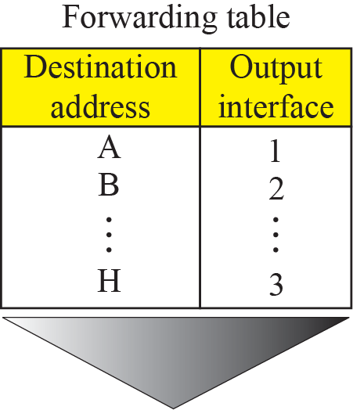
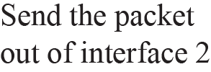
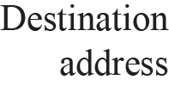
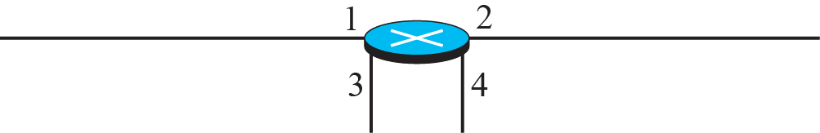
Forwarding process in a router when used in a connectionless network

Slide 8
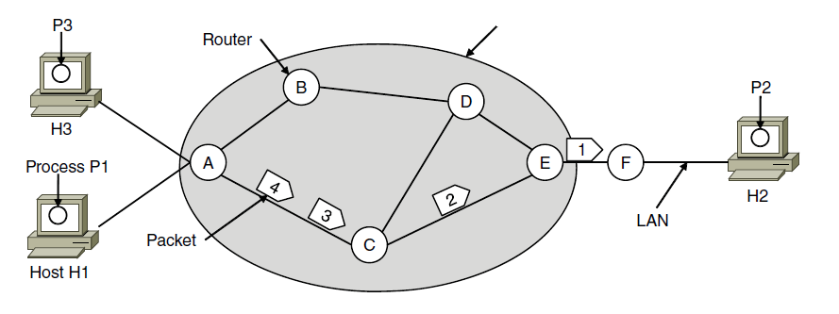
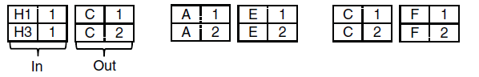
Connection-Oriented – Virtual Circuits
Packet is forwarded along a virtual circuit using tag inside it
Virtual circuit (VC) is set up ahead of time
ISP’s equipment
A’s table C’s Table E’s Table
In: Line Tag
Line Tag: Out
Notes:
This model is like the telephone network.
Packets contain tags that are not full addresses; they only need to be unique at a given link and thus are re-written at each router from an incoming tag to an outgoing tag. The virtual circuit is set up with the tag mapping along the entire path. Then packets are sent along it. The packets will thus all follow the same path (and arrive in order).
“Virtual” refers to the fact that real/physical telephone circuits have both a path and a fixed bandwidth reservation of 64Kbps, whereas virtual circuits may have a variable bandwidth depending on how many VCs use a single link.

Slide 9
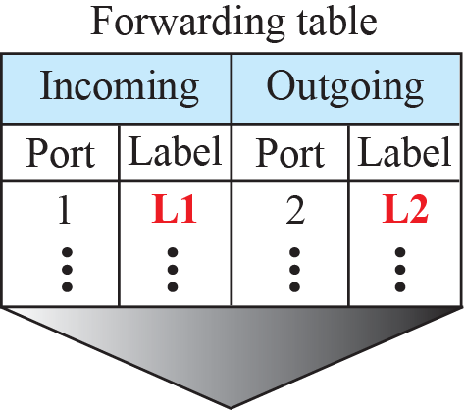
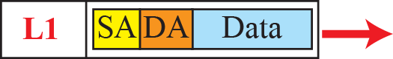

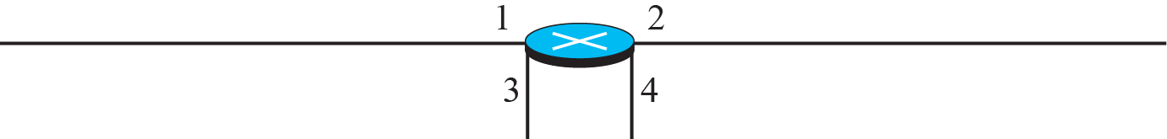
Forwarding process in a router when used in a virtual circuit network

Slide 10
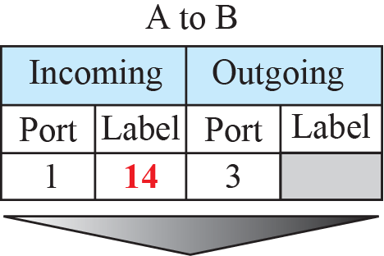
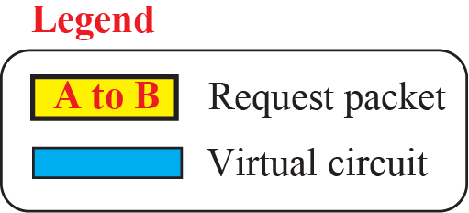
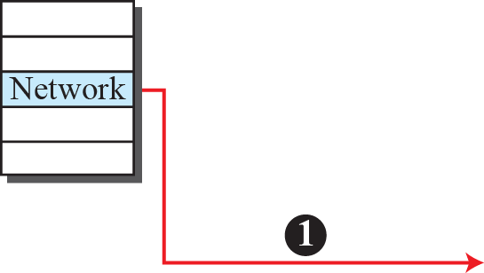
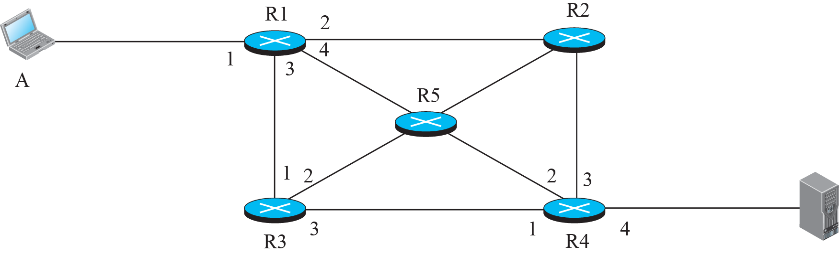
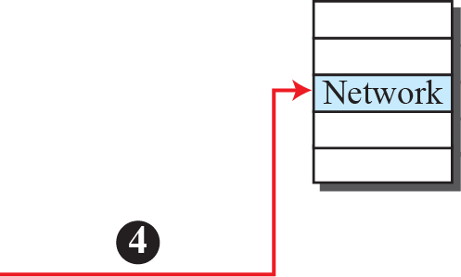
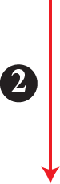
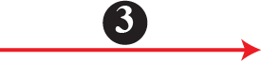
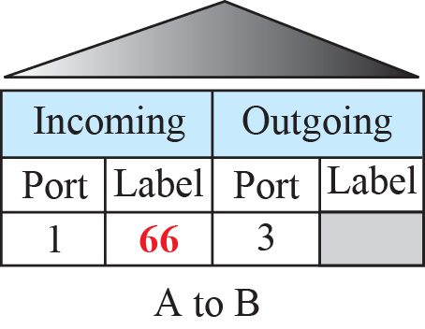
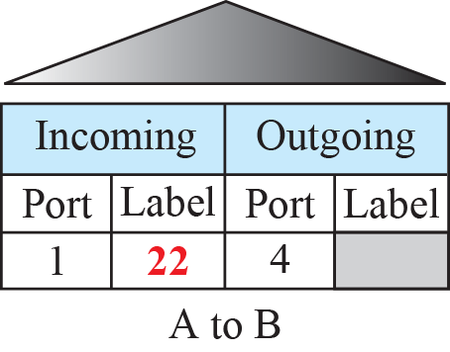
Sending request packet in a virtual-circuit network

Slide 11
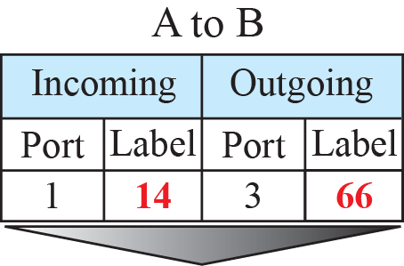
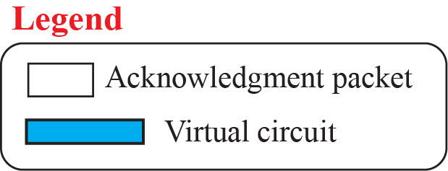
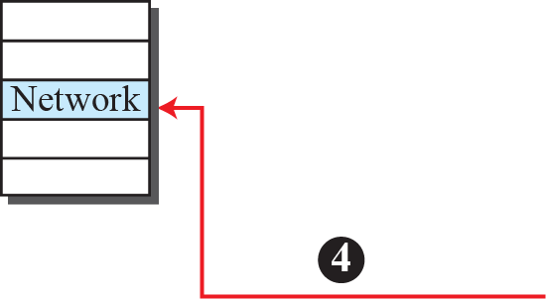
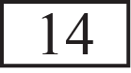
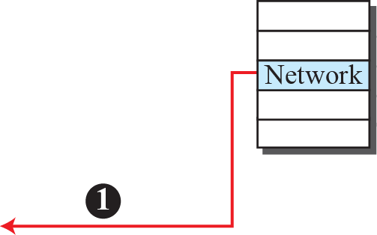


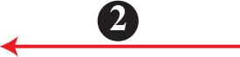
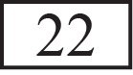

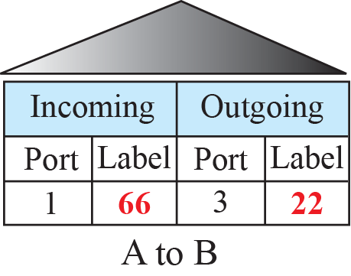
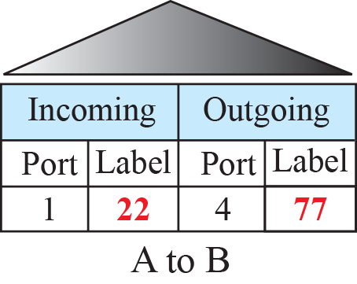
Sending acknowledgments in a virtual-circuit network

Slide 12
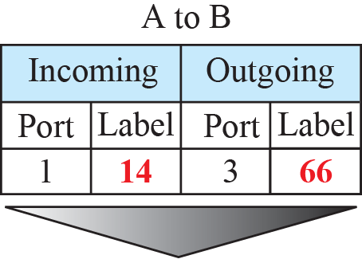
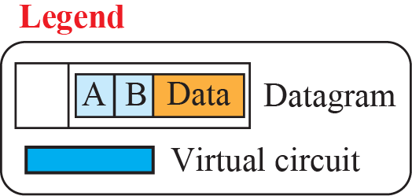
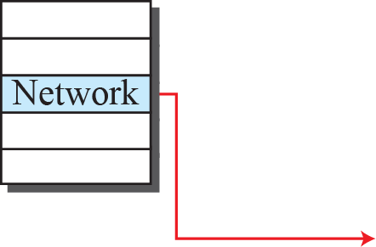
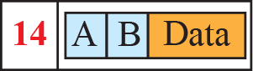
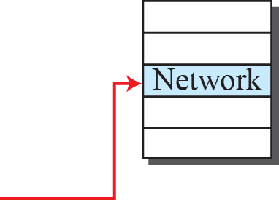

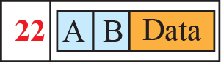
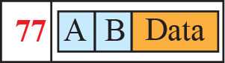
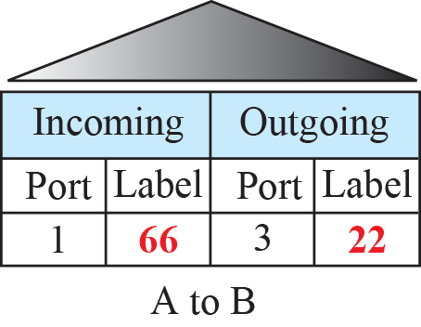
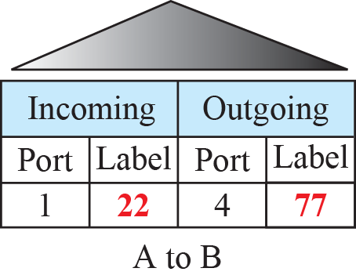
Flow of one packet in an established virtual circuit

Slide 13
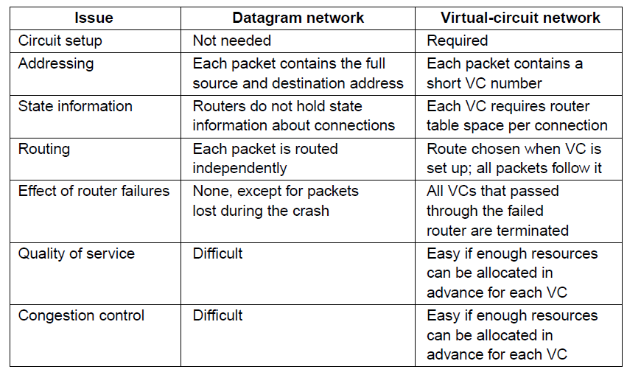
Comparison of Virtual-Circuits & Datagrams

Slide 14
Routing Algorithms (1)
Optimality principle »
Shortest path algorithm »
Flooding »
Distance vector routing »
Link state routing »
Hierarchical routing »
Broadcast routing »
Multicast routing »
Anycast routing »
Routing for mobile hosts »
Routing in ad hoc networks »
Notes:
Grayed out topics are optional and can be omitted without loss of continuity
In unicast routing, a packet is routed, hop by hop, from its source to its destination by the help of forwarding tables.
The source host needs no forwarding table because it delivers its packet to the default router in its local network.
The destination host needs no forwarding table either because it receives the packet from its default router in its local network.
Only the routers that glue together the networks in the internet need forwarding tables.

Slide 15
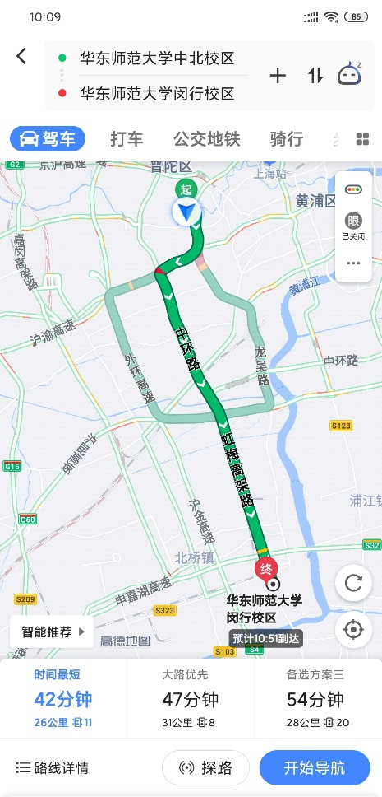
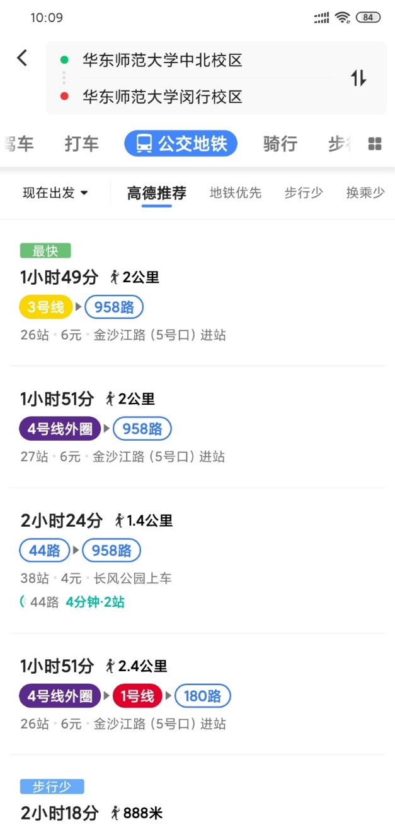
Routing in Daily Life
Notes:
路由算法：根据目的地进行路由选择决策
寻路的依据：成本(时间、费用)
静态VS动态：面对拥堵、封路等情况能否动态调整，事先确定好（公共交通）、随时进行（驾车）

Slide 16
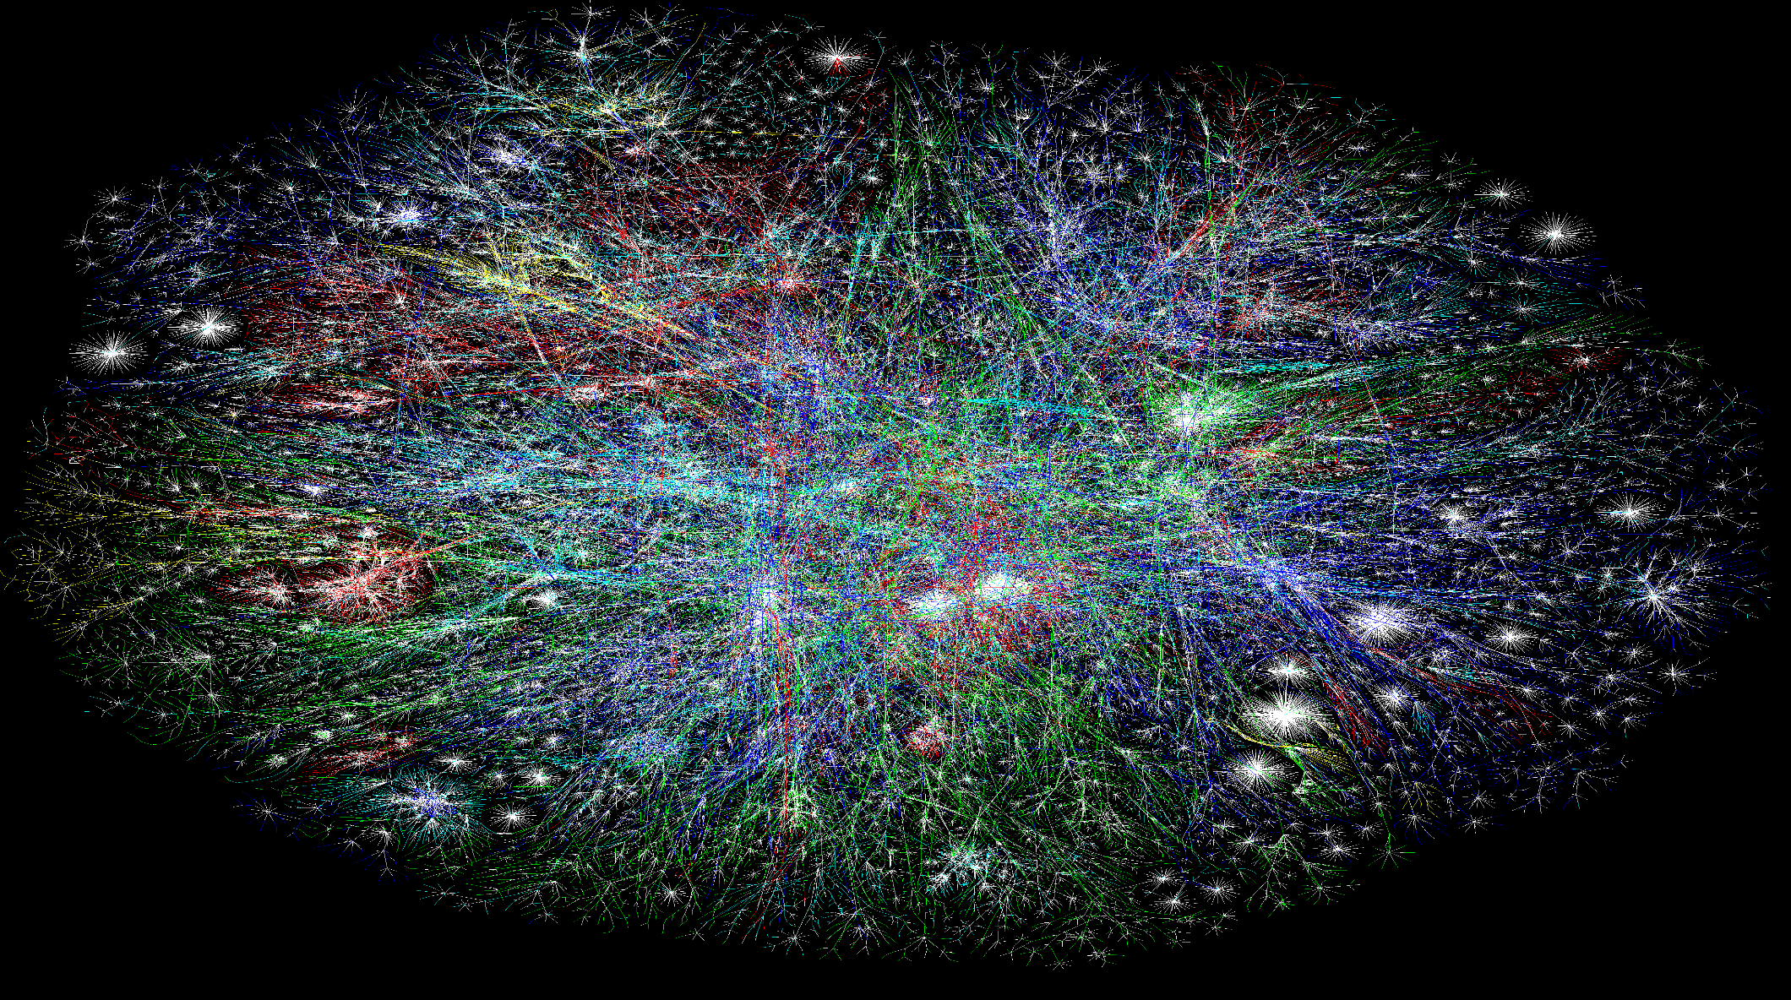
How to route in the Internet?
The Opte Project
Notes:
强调因特网发展迅猛、规模巨大、动态变化、高度复杂

Slide 17
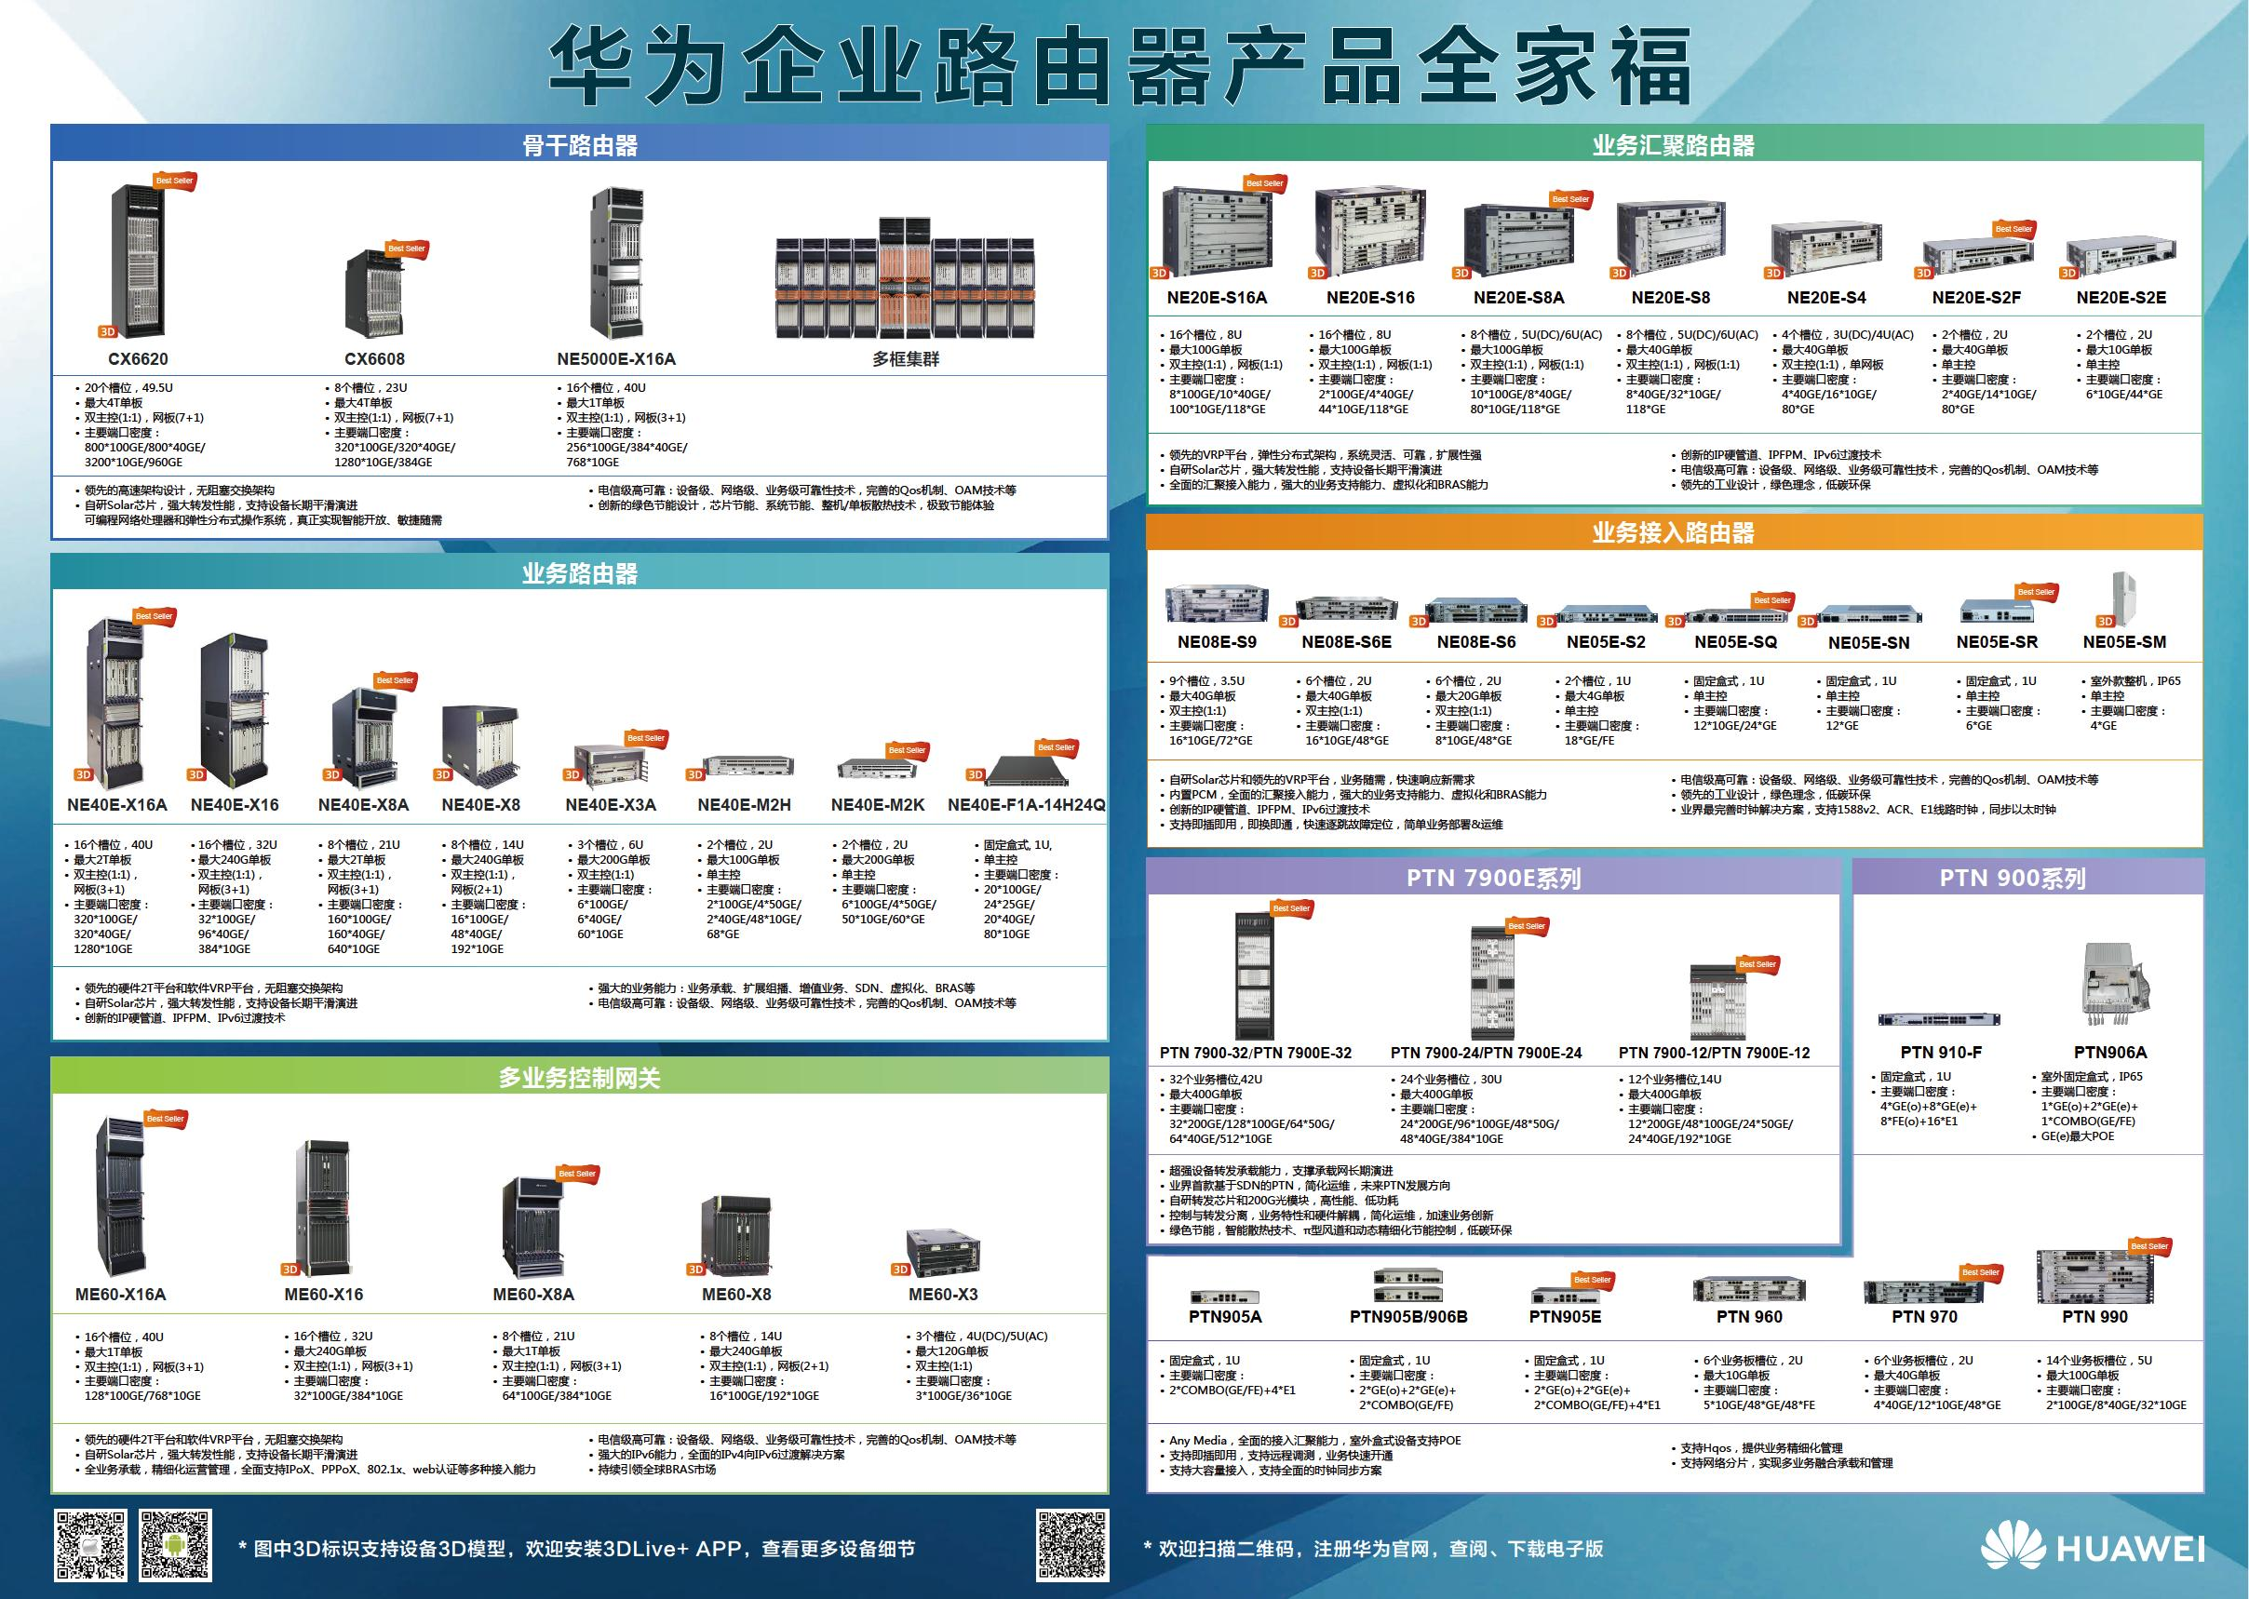
Routers
Notes:
澄清无线路由器（转发器，将本地的局域网挂载到Internet上）与一般意义上的路由器之间的差别。

Slide 18
Two Processes inside a Router
Routing: discover network paths
Make the decision which route to use
Fill and update the routing tables
Depends on a distributed algorithm
Forwarding: send packets along a path
When a packet arrives, taking a packet, looking at its destination, consulting a table, sending out the packet in a direction, determined by that table
Locally done at a node

Slide 19
Routing Algorithm
Model the network as a graph of nodes and links
Learn about the topology of the network
Manage routing tables
Make routing decisions
R1
1
R2
2
R3
Notes:
topology of the network: the set of all routers and links
weighted graph (vertex: router, edge: link, weight: cost)
Criterion: best path from source to destination
“best”: path cost is minimum

Slide 20
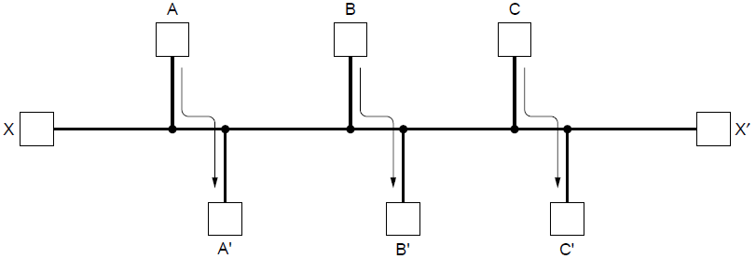
Routing Algorithms (2)
Decide what to optimize (e.g., fairness vs efficiency)
Update routes for changes in topology (e.g., failures)
Desired properties
Correctness
Simplicity
Robustness
Stability
Fairness
Optimality
Notes:
Distinguish routing from forwarding.
We focus on adaptive routing schemes that update routes in response to failures. Some traffic-aware schemes also adapt to changes in traffic, but we do not consider them in the algorithms that follow.
For the graph, the traffic demands are A->A’, B->B’, C->C’ and X->X’. What would be fair? For each flow the get the same amount of bandwidth. If all network links have unit capacity then we would give each flow ½ a unit of capacity. The total network traffic is then 2 units. What would be efficient? If we gave the X->X’ flow no bandwidth then we could give each of the other three flows 1 unit. The total network traffic is then 3 units. So it is more efficient, but it is not fair. So we will have to decide what we want to optimize.
Correctness
Simplicity
Robustness with respect to failures and changing conditions
Stability of the routing decisions
Fairness of the resource allocation
Optimality of the packet travel times

Slide 21
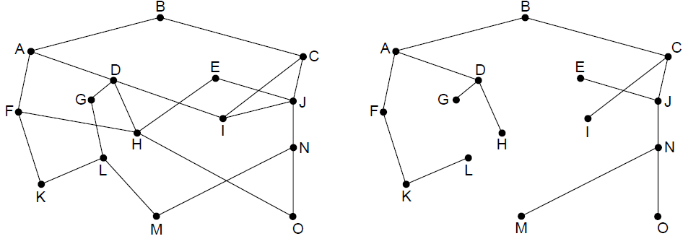
The Optimality Principle
Each portion of a best path is also a best path; the union of them to a router is a tree called the sink tree
Best means fewest hops in the example
B
Network
Sink tree of best paths to router B
Notes:
sink tree（汇集树）
Proof by contradiction: if a portion of a best path is not a best path then there is something better. Substitute this better portion and you would have a better overall path, which cannot be the case if the overall path is a best path.
For sink trees, if there are multiple paths that are equally good, then one best path from one node to another is chosen at random. For example, H can be reached in 3 hops via H-D-A-B as shown, or by H-F-A-D (not shown). This is simple and useful as there is a single route from each router to each destination. If, instead, all equally best paths are kept then their union is a DAG (directed acyclic graph). This is a more general case that permits multiple paths from a router to a destination.

Slide 22
Shortest Path Algorithm (1)
Dijkstra’s algorithm computes a sink tree on the graph:
Each link is assigned a non-negative weight/distance
Shortest path is the one with lowest total weight
Using weights of 1 gives paths with fewest hops
Algorithm:
Start with sink, set distance at other nodes to infinity
Relax distance to other nodes
Pick the lowest distance node, add it to sink tree
Repeat until all nodes are in the sink tree
Notes:
The notion of weight generalizes distance to other cost metrics. Setting weights to be 1 gives paths with fewest hops. Setting weight to be distance gives paths that are shortest or lowest delay. Setting weight to be lower for higher capacity links favors higher capacity paths.

Slide 23
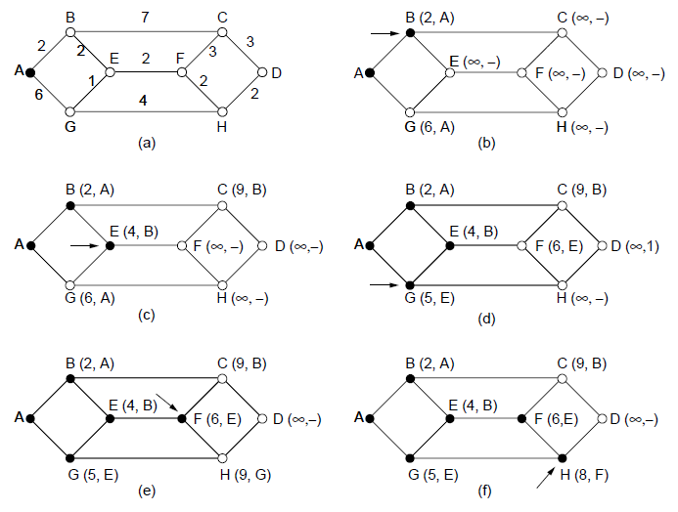
Shortest Path Algorithm (2)
A network and first five steps in computing the shortest paths from A to D. Pink arrows show the sink tree so far.

Slide 24
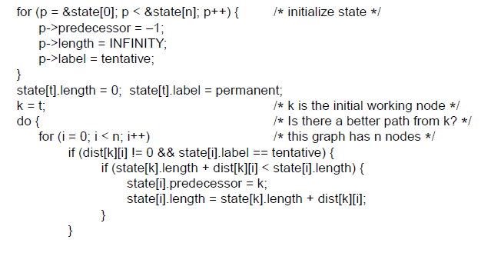
Shortest Path Algorithm (3)
. . .
Start with the sink, all other nodes are unreachable
Relaxation step. Lower distance to nodes linked to newest member of the sink tree
. . .

Slide 25
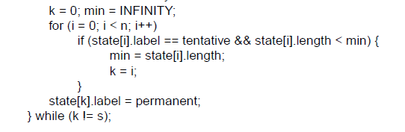
Shortest Path Algorithm (4)
. . .
Find the lowest distance, add it to the sink tree, and repeat until done
Notes:
This code keeps going until it reaches a sought-after destination node; if it continued until there were no tentative nodes then it would have found the entire sink tree.
The predecessor links can be reversed to find the path from t -> s instead of from s -> t. This is because the link has the same cost in each direction so paths are symmetrical (or the same in each direction).

Slide 26
Flooding
A simple method to send a packet to all network nodes
Each node floods a new packet received on an incoming link by sending it out all of the other links
Nodes need to keep track of flooded packets to stop the flood; even using a hop limit can blow up exponentially
Notes:
Note that flooding doesn’t actually find any routes that can be reused.

Slide 27
Distance Vector Routing
Distance vector is a distributed routing algorithm
Shortest path computation is split across nodes
Bellman-ford ( Ford-Fulkerson) Algorithm
The original ARPANET routing algorithm
Used by RIP, IGRP,…
Algorithm: “tell neighbors where I can go, and how far”
Each node knows distance of links to its neighbors
Each node advertises vector of lowest known distances to all neighbors
Each node uses received vectors to update its own
Repeat periodically
Notes:
How long will it take to converge? The diameter of the network.

Slide 28
Example of Distance Vector
A’s routing table
Destination Y | Cost/Next-Hop
A B C D E F G | 0/lo 1/B 1/C 2/C 1/E 1/F 2/F
B
A
C
E
D
F
G
Distance Vector sent by A

Slide 29
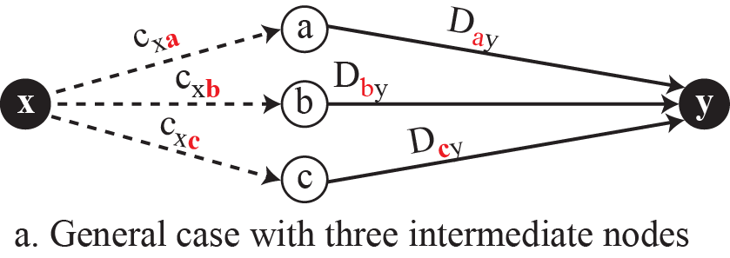

Graphical idea behind Bellman-Ford equation

Slide 30








The first distance vector for an internet

Slide 31



Updating distance vectors

Slide 32


The distance vector corresponding to a tree

Slide 33

Distance Vector Routing – An Example
Network
New vector for J
Vectors received at J from
Neighbors A, I, H and K

Slide 34
Excercises
B
A
C
Give the establishment process for each router’s routing table.
E
D
F
G
Destination Y |  | Node X’s Routing Table: Cost / Next-Hop
 |  | A’s | B’s | C’s | D’s | E’s | F’s | G’s
A |  | 0 | 1/A | 1/A | ∞ | 1/A | 1/A | ∞
B |  | 1/B | 0 | 1/B | ∞ | ∞ | ∞ | ∞
C |  | 1/C | 1/C | 0 | 1/C | ∞ | ∞ | ∞
D |  | ∞ | ∞ | 1/D | 0 | ∞ | ∞ | 1/D
E |  | 1/E | ∞ | ∞ | ∞ | 0 | ∞ | ∞
F |  | 1/F | ∞ | ∞ | ∞ | ∞ | 0 | 1/F
G |  | ∞ | ∞ | ∞ | 1/G | ∞ | 1/G | 0

Slide 35
After One Step
B
A
C
E
D
F
G
Destination Y |  | Node X’s Routing Table: Cost / Next-Hop
 |  | A’s | B’s | C’s | D’s | E’s | F’s | G’s
A |  | 0 | 1/A | 1/A | 2/C | 1/A | 1/A | 2/F
B |  | 1/B | 0 | 1/B | 2/C | 2/A | 2/A | ∞
C |  | 1/C | 1/C | 0 | 1/C | 2/A | 2/A | 2/D
D |  | 2/C | 2/C | 1/D | 0 | ∞ | 2/G | 1/D
E |  | 1/E | 2/A | 2/A | ∞ | 0 | 2/A | ∞
F |  | 1/F | 2/A | 2/A | 2/G | 2/A | 0 | 1/F
G |  | 2/F | ∞ | 2/D | 1/G | ∞ | 1/G | 0

Slide 36
After Two Step
B
A
C
E
D
F
G
Destination Y |  | Node X’s Routing Table: Cost / Next-Hop
 |  | A’s | B’s | C’s | D’s | E’s | F’s | G’s
A |  | 0 | 1/A | 1/A | 2/C | 1/A | 1/A | 2/F
B |  | 1/B | 0 | 1/B | 2/C | 2/A | 2/A | 3/F
C |  | 1/C | 1/C | 0 | 1/C | 2/A | 2/A | 2/D
D |  | 2/C | 2/C | 1/D | 0 | 3/A | 2/G | 1/D
E |  | 1/E | 2/A | 2/A | 3/C | 0 | 2/A | 3/F
F |  | 1/F | 2/A | 2/A | 2/G | 2/A | 0 | 1/F
G |  | 2/F | 3/C | 2/D | 1/G | 3/A | 1/G | 0
Notes:
convergence: no more changes when getting further announcement

Slide 37

The Count-to-Infinity Problem
Failures can cause DV to “count to infinity” while seeking a path to an unreachable node
X
Good news of a path to A spreads quickly
Bad news of no path to A is learned slowly

Slide 38
Link State Routing (1)
Link state is an alternative to distance vector
“tell all which neighbors I have”
More computation but simpler dynamics
Widely used in the Internet (OSPF, ISIS)
Algorithm:
Each node floods information about its neighbors in LSPs (Link State Packets); all nodes learn the full network graph
Each node runs Dijkstra’s algorithm to compute the path to take for each destination
Notes:
耳听为虚，眼见为实

Slide 39

Link State Routing (2) – LSPs
LSP (Link State Packet) for a node lists neighbors and weights of links to reach them
Network
LSP for each node

Slide 40

Link State Routing (3) – Reliable Flooding
Seq. number and age are used for reliable flooding
New LSPs are acknowledged on the lines they are received and sent on all other lines
Example shows the LSP database at router B
Notes:
In the example, B has links to A, C and F in the network. It received LSPs from A, C, and F directly and so acknowledged A, C, and F respectively and sent that LSP on both other links. But B received E and D on two links, so it acknowledged both and sent only on the third link.

Slide 41

Hierarchical Routing
Hierarchical routing reduces the work of route computation but may result in slightly longer paths than flat routing
Best choice to reach nodes in 5 except for 5C
Notes:
Hierarchical routing is what you think it is, e.g., to reach a given telephone first head towards the right country, then the right city in the country, then the phone in the city.
Each node keeps only one entry per region for other regions, plus an entry for all nodes in the local region.
The advantages are smaller routing tables, smaller routing computations to run at nodes, and fewer/smaller messages to send to describe the network.

Slide 42

Broadcast Routing
Broadcast sends a packet to all nodes
RPF (Reverse Path Forwarding): send broadcast received on the link to the source out all remaining links
Alternatively, can build and use sink trees at all nodes
Network
Sink tree for I is efficient broadcast
RPF from I is larger than sink tree
Notes:
Why use RPF? It requires only the regular (unicast) routing table at each node, such as built by distance vector, so it can be widely used. Sink trees are only available with a protocol that explicitly computes them such as link state. Note that broadcast with sink trees requires each node to compute all sink trees, since the broadcast is forwarded by looking up the sink tree for the source at each node, not a single broadcast tree for the network (as in the LAN spanning tree). However, using sink trees is more efficient since RPF over-sends. For example, D is reached from F (going down the sink tree), as well as from G (going out all remaining links).

Slide 43

Multicast Routing (1) – Dense Case
Multicast sends to a subset of the nodes called a group
Uses a different tree for each group and source
S
Network with groups 1 & 2
Spanning tree from source S
S
S
Multicast tree from S to group 1
Multicast tree from S to group 2
Notes:
The example shows two of the multicast trees computed in the network. There are many more, the number of nodes times the number of groups. This is worth the effort when the group densely cover the network, i.e., most groups affect most nodes in the network so it makes sense for all nodes to build an efficient multicast tree.

Slide 44

Multicast Routing (2) – Sparse Case
CBT (Core-Based Tree) uses a single tree to multicast
Tree is the sink tree from core node to group members
Multicast heads to the core until it reaches the CBT
p 1.
Sink tree from core to group 1
Multicast is send to the core then down when it reaches the sink tree
Notes:
Tradeoff is that CBT is less efficient than computing the spanning tree for each source to reach each group, but it is less work to scale to large networks and many groups. Now, with CBT, nodes that are not on the group spanning tree do not need to compute it and can simply send to the core node using their regular routing tables. This is a good tradeoff when the groups sparsely cover the network, i.e., there are many groups that most nodes do not need to know about.

Slide 45

Anycast Routing
Anycast sends a packet to one (nearest) group member
Falls out of regular routing with a node in many places
Anycast routes to group 1
Apparent topology of sink tree to “node” 1
Notes:
We will see later that anycast is used in practice to reach the nearest root DNS server.

Slide 46

Routing for Mobile Hosts
Mobile hosts can be reached via a home agent
Fixed home agent tunnels packets to reach the mobile host; reply can optimize path for subsequent packets
No changes to routers or fixed hosts
Notes:
The tradeoff that is being made here is that the routing system that computes spanning trees is not being changed at all, but routes to reach mobile hosts can be circuitous when the mobile is far from home.

Slide 47

Routing in Ad Hoc Networks
The network topology changes as wireless nodes move
Routes are often made on demand, e.g., AODV (below)
A’s starts to find route to I
A’s broadcast reaches B & D
B’s and D’s broadcast reach C, F & G
C’s, F’s and G’s broadcast reach H & I

Slide 48
Network Layer Chapter 5
Design Issues
Routing Algorithms
Congestion Control
Quality of Service
Internetworking
Network Layer of the Internet

Slide 49
The Network Layer
Responsible for delivering packets between endpoints over multiple links
Application
Transport
Network
Link
Physical

Slide 50
Network Performance
The performance of a network can be measured in terms of delay, throughput, and packet loss.
Delay: transmission delay, propagation delay, processing delay, and queuing delay.
Throughput at any point in a network: the number of bits passing through the point in a second, i.e., the transmission rate of data at that point.
Packet loss: the number of packets lost during transmission.
Congestion control is a mechanism for improving performance.
Notes:
When a router receives a packet while processing another packet, the received packet needs to be stored in the input buffer waiting for its turn.
A router has an input buffer with a limited size.
A time may come when the buffer is full and the next packet needs to be dropped.
The effect of packet loss on the Internet network layer is that the packet needs to be resent, which in turn may create overflow and cause more packet loss.

Slide 51
Congestion Control (1)
Handling congestion is the responsibility of the Network and Transport layers working together
We look at the Network portion here
Traffic-aware routing »
Admission control »
Traffic throttling »
Load shedding »

Slide 52

Congestion Control (2)
Congestion results when too much traffic is offered; performance degrades due to loss/retransmissions
Goodput (=useful packets) trails offered load
Notes:
As offered load increases, goodput should increase correspondingly until the capacity of the network is reached. Goodput will trail offered load because the load is bursty and queues will occasionally be too full and a packet will be discarded inside the network.
Congestion collapse can occur if the protocols are not carefully designed when nodes retransmit packets many times, believing that they have been lost, when copies of the packet are still in the network (in queues at routers) pending delivery. While throughput at a receiver may be high, goodput falls because multiple copies of the same packet are being received and after the first copy the bandwidth is wasted.
This really happened in the late 1980s as the Internet grew, and it lead to the design of modern TCP that includes congestion control mechanisms.

Slide 53

Congestion Control (3) – Approaches
Network must do its best with the offered load
Different approaches at different timescales
Nodes should also reduce offered load (Transport)
Notes:
Provisioning is simply sizing the network to fit the offered load, i.e., don’t build it too small, or with little West-to-East capacity if there is much West-to-East traffic.

Slide 54

Traffic-Aware Routing
Choose routes depending on traffic, not just topology
E.g., use EI for West-to-East traffic if CF is loaded
But take care to avoid oscillations
Notes:
Our previous routes only considered topology; this approach can get more traffic through the network.
If not careful, then routing can notice CF is busy and switch traffic over to use EI, only to later notice that EI is busy and switch traffic back to CF. There are various techniques to avoid this: 1) change routes only slowly, e.g., traffic engineering in which an external system sets weights and the routing system does not otherwise adapt; and 2) using multiple paths at once, e.g., both CF and EI.

Slide 55

Admission Control
Admission control allows a new traffic load only if the network has sufficient capacity, e.g., with virtual circuits
Can combine with looking for an uncongested route
Network with some congested nodes
Uncongested portion and route AB around congestion

Slide 56

Traffic Throttling
Congested routers signal hosts to slow down traffic
ECN (Explicit Congestion Notification) marks packets and receiver returns signal to sender
Notes:
There are other designs, but this is the main one under deployment in the Internet. By marking existing packets using bits in the IP header, routers avoid sending additional packets at a time of congestion. Signal from receiver to sender is carried using a Transport protocol like TCP.
The general strategy is sometimes called active queue management. It is particularly valuable to TCP flows that have large delay-bandwidth products.

Slide 57


Load Shedding (1)
When all else fails, network will drop packets (shed load)
Can be done end-to-end or link-by-link
Link-by-link (right) produces rapid relief
1
4
2
5
3

Slide 58


Load Shedding (2)
1
End-to-end (right) takes longer to have an effect, but can better target the cause of congestion
5
2
6
3
7
4

Slide 59
Quality of Service
Application requirements »
Traffic shaping »
Packet scheduling »
Admission control »
Integrated services »
Differentiated services »

Slide 60

Application Requirements (1)
Different applications care about different properties
We want all applications to get what they need
.
Reliability
“High” means a demanding requirement, e.g., low delay

Slide 61
Application Requirements (2)
Network provides service with different kinds of QoS (Quality of Service) to meet application requirements
Network Service | Application
Constant bit rate | Telephony
Real-time variable bit rate | Videoconferencing
Non-real-time variable bit rate | Streaming a movie
Available bit rate | File transfer
Example of QoS categories from ATM networks
Notes:
Video conferencing is variable bit rate because video is normally compressed, so the bit rate varies over time. Telephony is typically carried at a lower, fixed rate.

Slide 62

Traffic Shaping (1)
Traffic shaping regulates the average rate and burstiness of data entering the network
Lets us make guarantees
Shape traffic here

Slide 63
Traffic Shaping (2)
Token/Leaky bucket limits both the average rate (R) and short-term burst (B) of traffic
For token, bucket size is B, water enters at rate R and is removed to send; opposite for leaky.
to send
to send
Leaky bucket
(need not full to send)
Token bucket
(need some water to send)

Slide 64


Traffic Shaping (3)
Host traffic
R=200 Mbps B=16000 KB
Shaped by R=200 Mbps B=9600 KB
Shaped by R=200 Mbps B=0 KB
Smaller bucket size delays traffic and reduces burstiness
Notes:
For the host traffic the descriptor R=200 Mbps, B=16000KB is the smallest token bucket that can let the traffic pass unchanged. To compute this we work out R as the average rate over the time period, then given we find the smallest B such that the bucket size only just reaches zero at some point.

Slide 65

Packet Scheduling (1)
Packet scheduling divides router/link resources among traffic flows with alternatives to FIFO (First In First Out)
1
1
1
2
2
3
3
3
Example of round-robin queuing

Slide 66

Packet Scheduling (2)
Fair Queueing approximates bit-level fairness with different packet sizes; weights change target levels
Result is WFQ (Weighted Fair Queueing)
F_{i} = max(A_{i}, F_{i-1}) + L_{i}/W
Packets may be sent out of arrival order
Finish virtual times determine transmission order
Notes:
Virtual times are measured in rounds, where a round lets each input queue send 1 bit for weight 1, or W bits for weight W. The time to send a packet of length L is thus L/W. The formula says that the finish virtual time for a packet is the larger of its arrival time plus the time to send it, or the finish time of the previous packet in the same queue plus the time to send it.

Slide 67

Admission Control (1)
Admission control takes a traffic flow specification and decides whether the network can carry it
Sets up packet scheduling to meet QoS
Example flow specification

Slide 68

Admission Control (2)
Construction to guarantee bandwidth B and delay D:
Shape traffic source to a (R, B) token bucket
Run WFQ with weight W / all weights > R/capacity
Holds for all traffic patterns, all topologies
Notes:
Bandwidth is guaranteed at each router by setting a high enough weight on the flow; if this cannot be done then the flow must not be admitted.
Delay guarantees are more subtle and the bound is not given here. Essentially a burst of traffic can arrive at one router and be delayed but then it will not be delayed at other routers because it has already been shaped to be less bursty. So the total delay is something like the propagation delay plus B/R.

Slide 69
Integrated Services (1)
Design with QoS for each flow; handles multicast traffic.
Admission with RSVP (Resource reSerVation Protocol):
Receiver sends a request back to the sender
Each router along the way reserves resources
Routers merge multiple requests for same flow
Entire path is set up, or reservation not made

Slide 70

Integrated Services (2)
Merge
R3 reserves flow from S1
R3 reserves flow from S2
R5 reserves flow from S1; merged with R3 at H

Slide 71

Differentiated Services (1)
Design with classes of QoS; customers buy what they want
Expedited class is sent in preference to regular class
Less expedited traffic but better quality for applications

Slide 72

Differentiated Services (2)
Implementation of DiffServ:
Customers mark desired class on packet
ISP shapes traffic to ensure markings are paid for
Routers use WFQ to give different service levels

Slide 73
Internetworking
Internetworking joins multiple, different networks into a single larger network
How networks differ »
How networks can be connected »
Tunneling »
Internetwork routing »
Packet fragmentation »

Slide 74

How Networks Differ
Differences can be large; complicates internetworking

Slide 75

How Networks Can Be Connected
Internetworking based on a common network layer – IP
Packet mapped to a VC here
Common protocol (IP) carried all the way
Notes:
The top half of the figure shows the difficulties – a packet sent as a datagram may suddenly have to be sent over a virtual circuit, which requires some way to map between the two.
The bottom half shows the solution – a common network layer protocol, IP, carries addresses and other information that identify the endpoints across networks.

Slide 76

Tunneling (1)
Connects two networks through a middle one
Packets are encapsulates over the middle

Slide 77

Tunneling (2)
Tunneling analogy:
tunnel is a link; packet can only enter/exit at ends

Slide 78

Packet Fragmentation (1)
Networks have different packet size limits for many reasons
Large packets sent with fragmentation & reassembly
G₁ fragments
G₂ reassembles
G₃ fragments
G₄ reassembles
Transparent – packets fragmented / reassembled in each network
… destination will reassemble
G₁ fragments
Non-transparent – fragments are reassembled at destination

Slide 79





Packet Fragmentation (2)
Example of IP-style fragmentation:
Packet
number
Start
offset
End
bit
Original packet:
(10 data bytes)
Fragmented:
(to 8 data bytes)
Re-fragmented:
(to 5 bytes)

Slide 80

Packet Fragmentation (3)
Path MTU Discovery avoids network fragmentation
Routers return MTU (Max. Transmission Unit) to source and discard large packets
Try 1200
Try 900

Slide 81
Network Layer Chapter 5
Design Issues
Routing Algorithms
Congestion Control
Quality of Service
Internetworking
Network Layer of the Internet

Slide 82
The Network Layer
Responsible for delivering packets between endpoints over multiple links
Application
Transport
Network
Link
Physical

Slide 83
Network Layer in the Internet
IP Version 4 »
IP Addresses »
IP Version 6 »
Internet Control Protocols »
Label Switching and MPLS »
OSPF—An Interior Gateway Routing Protocol »
BGP—The Exterior Gateway Routing Protocol »
Internet Multicasting »
Mobile IP »

Slide 84
10 Design Principles of IP Protocol
IP has been shaped by guiding principles:
Make sure it works
Keep it simple
Make clear choices
Exploit modularity
Expect heterogeneity
Avoid static options and parameters
Look for good design (not perfect)
Strict sending, tolerant receiving
Think about scalability
Consider performance and cost
Notes:
Very much an open working design that has favored simplicity and practical engineering considerations rather than design by committee.

Slide 85

Network Layer in the Internet
Internet is an interconnected collection of many networks that is held together by the IP protocol

Slide 86

Position of IP and other network-layer protocols in TCP/IP protocol suite

Slide 87

IP Version 4 Protocol
IPv4 (Internet Protocol) header is carried on all packets and has fields for the key parts of the protocol:

Slide 88



Multiplexing and demultiplexing using the value of the protocol field

Slide 89
Example
An IPv4 packet has arrived with the first 8 bits as shown:
01000010
The receiver discards the packet. Why?
Solution
There is an error in this packet. The 4 leftmost bits (0100) show the version, which is correct. The next 4 bits (0010) show an invalid header length (2 × 4 = 8). The minimum number of bytes in the header must be 20. The packet has been corrupted in transmission.

Slide 90
Example
In an IPv4 packet, the value of HLEN is 1000 in binary. How many bytes of options are being carried by this packet?
Solution
The HLEN value is 8, which means the total number of bytes in the header is 8 × 4, or 32 bytes. The first 20 bytes are the base header, the next 12 bytes are the options.

Slide 91

Example
An IPv4 packet has arrived with the first few hexadecimal digits as shown.
How many hops can this packet travel before being dropped? The data belong to what upper-layer protocol?
Solution
To find the time-to-live field, we skip 8 bytes (16 hexadecimal digits). The time-to-live field is the ninth byte, which is (01)₁₆. This means the packet can travel only one hop. The protocol field is the next byte (02)₁₆, which means that the upper-layer protocol is IGMP.

Slide 92



An example of a checksum calculation for an IPv4 header without options
The header is divided into 16-bit sections.
All the sections are added and the sum is complemented after wrapping the leftmost digit.
The result is inserted in the checksum field.

Slide 93
Why the checksum in IPv4 covers only the header, not the data?
Notes:
为什么IPv4的checksum字段仅对IPv4头部进行校验？
1.IPv4数据报中所有的高层协议均有校验和字段来对整个分组进行校验；
2.IPv4头部在经过路由器是会发生改变，而数据字段不变，即校验和仅需要对变化的部分进行校验。
如果对整个分组进行校验，则会增加处理时间。

Slide 94


Maximum transfer unit (MTU)
MTUs for some networks
Notes:
A datagram can travel through different networks. Each router decapsulates the IP datagram from the frame it receives, processes it, and then encapsulates it in another frame.
The format and size of the received frame depend on the protocol used by the physical network through which the frame has just traveled.
The format and size of the sent frame depend on the protocol used by the physical network through which the frame is going to travel.
For example, if a router connects a LAN to a WAN, it receives a frame in the LAN format and sends a frame in the WAN format.

Slide 95
IP Fragmentation and Reassembly
length
=4000
ID
=x
fragflag
=0
offset
=0
Example
4000 byte datagram
MTU = 1500 bytes
One large datagram becomes
several smaller datagrams
length
=1500
ID
=x
fragflag
=1
offset
=0
1480 bytes in data field
length
=1500
ID
=x
fragflag
=1
offset
=185
offset =
1480/8
length
=1040
ID
=x
fragflag
=0
offset
=370

Slide 96
Example: Fragmenting a Packet
A packet is to be forwarded to a network with MTU of 576 bytes. The packet has an IP header of 20 bytes and a data part of 1484 bytes.
For each fragment, Maximum data length per fragment = 576 - 20 = 556 bytes.
We set maximum data length to 552 bytes to get multiple of 8.
 | Total Length | Id | MF | Fragment Offset
Original packet | 1504 | x | 0 | 0
Fragment 1 | 572 | x | 1 | 0
Fragment 2 | 572 | x | 1 | 69
Fragment 3 | 400 | x | 0 | 138

Slide 97
Example
A packet has arrived in which the offset value is 100, the value of HLEN is 5, and the value of the total length field is 100. What are the numbers of the first byte and the last byte?
Solution
The first byte number is 100 × 8 = 800. The total length is 100 bytes, and the header length is 20 bytes (5 × 4), which means that there are 80 bytes in this datagram. If the first byte number is 800, the last byte number must be 879.

Slide 98
IPv4 Addresses
An IPv4 address is a 32-bit address that uniquely and universally defines the connection of a device (for example, a computer or a router) to the Internet.
The address space of IPv4 is 2³² or 4,294,967,296.

Slide 99

Dotted-decimal Notation and Binary notation
for an IPv4 address

Slide 100
Example
Find the error, if any, in the following IPv4 addresses.
Solution
a. There must be no leading zero (045).
b. There can be no more than four bytes in IP address.
c. Each number needs to be less than or equal to 255.
d. A mixture of binary notation and dotted-decimal notation is not allowed.

Slide 101

Hierarchy in IP Addresses
Addresses are allocated in blocks called prefixes
Prefix is determined by the network portion
Has 2^{L} addresses aligned on 2^{L} boundary
Written address/length, e.g., 18.0.31.0/24

Slide 102




Information extraction in classless addressing
Set all suffix bits
to 0s
Set all suffix bits
to 1s

Slide 103

A network configuration for the block 205.16.37.32/28

Slide 104

Which address block does an IP address belong to?
In classless addressing, an address cannot per se define the block the address belongs to.
For example, the address 230.8.24.56 can belong to many blocks. Some of them are shown below with the value of the prefix associated with that block.

Slide 105

Classful Addresing
Old addresses came in blocks of fixed size (A, B, C)
Carries size as part of address, but lacks flexibility
Called classful (vs. classless) addressing
Notes:
This is just history. Prefixes are variable size, which is much more flexible and suits different kinds of usage, but now the prefix length needs to be carried separately by the routing protocols because it is not part of the address.

Slide 106

Special IP addresses

Slide 107
Example
Find the class of each address.
a. 00000001 00001011 00001011 11101111
b. 11000001 10000011 00011011 11111111
c. 14.23.120.8
d. 252.5.15.111
Solution
a. The first bit is 0. This is a class A address.
b. The first 2 bits are 1; the third bit is 0. This is a class C address.
c. The first byte is 14; the class is A.
d. The first byte is 252; the class is E.

Slide 108
Number of blocks and block size in classful IPv4 addressing
Default masks for classful addressing

Slide 109

Subnets
Subnetting splits up IP prefix to help with management
Looks like a single prefix outside the network
ISP gives network
a single prefix
Network divides it into subnets internally
Notes:
Check the size of the different subnets:
Prefix has 2^16=32K addresses, CS subnet is largest, 2^15=16K addresses, EE subnet has 2^14=8K addresses, Art has 2^13=4K addresses.
There are 4K addresses left over. What is the prefix? It is found by writing the address ranges out to see that 128.208.64.0/19 is left.
Can the prefix lengths just be changed between EE/CS/Art? No, then blocks of size 2^N would not always be aligned on a 2^N boundary.

Slide 110

Subnet Addressing
Subnet addressing introduces another hierarchical level
Transparent to remote networks
Simplifies management of multiplicity of LANs
Masking used to find subnet number
A class B network subnetted into 64 subnets.
Notes:
子网掩码可以用点分十进制标记法来表示，也可以用”/”并跟上”网络+子网“部分的位数。如上图的例子，子网掩码可以写成255.255.252.0。另一种标记是用”/22“来表示子网掩码有22位长。
P.440例子。
未实使用子网时，每个路由表中列出一些形如（网络,0）的IP地址和一些形如（当前网络，主机）的IP地址。每个表项与能够到达该目标网络的网络接口关联。第一种IP地址说明如何到达远程网络；第二种IP地址说明如何到达本地主机。
当引入子网划分以后，路由表也变了，它加入了形如（当前网络，子网，0）和（当前网络，当前子网，主机）的表项。实际上，每台路由器只需将分组的目标地址与网络的子网掩码进行”与“操作便可消除主机号，然后在路由表中查找确定转发端口。

Slide 111
Subnetting Example
Organization has Class B address (16 host ID bits) with network ID: 150.100.0.0
Create subnets with up to 100 hosts each
7 bits sufficient for each subnet
16-7=9 bits for subnet ID
Apply subnet mask to IP addresses to find corresponding subnet
Example: Find subnet for 150.100.12.176
IP add = 10010110 01100100 00001100 10110000
Mask = 11111111 11111111 11111111 10000000
AND = 10010110 01100100 00001100 10000000
Subnet = 150.100.12.128
Subnet address used by routers within organization

Slide 112

Configuration and Addresses in a Subnetted Network
16
32
16

Slide 113

Three-level hierarchy in an IPv4 address

Slide 114

CIDR – Classless InterDomain Routing
A set of IP address assignments.
5-59
Notes:
CIDR——无类别域间路由。是一种为解决地址耗尽而提出的一种措施。它是将好几个IP网络结合在一起，即将剩余的IP地址以可变大小块的方式进行分配，而不管它们所属的类别。CIDR使用一种无类别的域间路由选择算法，可以减少由核心路由器运载的路由选择信息的数量 ：当一个分组到来的时候，路由器首先将它的目标IP地址提取出来，然后用掩码去”与“目标地址，再将它与路由表项中的网络号进行比较，看两者是否匹配。如果找到多个匹配的表项（这些表项的子网掩码长度不同），则使用掩码长度最长的那个表项。CIDR将路由集中起来，使一个IP地址代表主要骨干提供商服务的几千个IP地址，从而减轻Internet路由器的负担。 PP.443-444例子。
CIDR建立于“超级组网”的基础上，“超级组网”是“子网划分”的派生词，可看作子网划分的逆过程。子网划分时，从地址主机部分借位，将其合并进网络部分；而在超级组网中，则是将网络部分的某些位合并进主机部分。这种无类别超级组网技术通过将一组较小的无类别网络汇聚为一个较大的单一路由表项，减少了Internet路由域中路由表条目的数量。

Slide 115
Example
An ISP is granted a block of addresses starting with 190.100.0.0/16 (65,536 addresses). The ISP needs to distribute these addresses to three groups of customers as follows:
a. The first group has 64 customers; each needs 256 addresses.
b. The second group has 128 customers; each needs 128 addresses.
c. The third group has 128 customers; each needs 64 addresses.
Design the subblocks and find out how many addresses are still available after these allocations.

Slide 116
Example (continued)
Solution
Group 1
For this group, each customer needs 256 addresses. This means that 8 (log2 256) bits are needed to define each host. The prefix length is then 32 − 8 = 24. The addresses are

Slide 117
Example (continued)
Group 2
For this group, each customer needs 128 addresses. This means that 7 (log2 128) bits are needed to define each host. The prefix length is then 32 − 7 = 25. The addresses are

Slide 118
Example (continued)
Group 3
For this group, each customer needs 64 addresses. This means that 6 (log₂64) bits are needed to each host. The prefix length is then 32 − 6 = 26. The addresses are
Number of granted addresses to the ISP: 65,536
Number of allocated addresses by the ISP: 40,960
Number of available addresses: 24,576

Slide 119

An example of address allocation and
distribution by an ISP

Slide 120

IP Address Aggregation
Aggregation joins multiple IP prefixes into a single larger prefix to reduce routing table size
ISP advertises
a single prefix
ISP customers have different prefixes
Notes:
Same mechanism as subnets, just a different motivation (of reducing the size of routing tables instead of making it easier to use the block of addresses you have).

Slide 121
Supernet : an example
Internet part
Local part
Network ID
Host ID
Four class C networks were put together to form the supernet:
192.230.20. 0
192.230.21. 0
192.230.22. 0
192.230.23. 0
The address of lowest network together with the supernet mask is required in the global routers for routing : 192.230.20.0 / 22
11000000 11100110 00010100 00000000
11000000 11100110 00010101 00000000
11000000 11100110 00010110 00000000
11000000 11100110 00010111 00000000

Slide 122

Longest Matching Prefix
Packets are forwarded to the entry with the longest matching prefix or smallest address block
Complicates forwarding but adds flexibility
Except for this part!
Main prefix goes this way
Notes:
At New York, the LMP rule makes it easy to add an exception to go elsewhere to reach part of a prefix. Without it, we would have had to split the prefix up into its components and give a route for each component.

Slide 123

Simplified forwarding module in classless address

Slide 124


Exercises
Make a forwarding table for router R1 using the configuration in the figure. Show the forwarding process if a packet arrives at R1 with the destination address 180.70.65.140.

Slide 125
Exercises (cont.)
The router performs the following steps:
1. The first mask (/26) is applied to the destination address. The result is 180.70.65.128, which does not match the corresponding network address.
2. The second mask (/25) is applied to the destination address. The result is 180.70.65.128, which matches the corresponding network address. The next-hop address and the interface number m0 are extracted for forwarding the packet.

Slide 126

NAT
NAT (Network Address Translation) box maps one external IP address to many internal IP addresses
Uses TCP/UDP port to tell connections apart
Violates layering; very common in homes, etc.
Notes:
So Internet traffic sent to/from port 1111 might really be going to a computer A in the home while traffic sent to/from port 2222 to the same IP address might be going to a computer B.
The mapping in the NAT box is set up when a connection is established. A side-effect is that connections can only be made from inside the house to the Internet – you can’t run a server in your home without special configuration. This is a consequence of violating layering.

Slide 127

NAT – Network Address Translation
Addresses for private networks

Slide 128

A NAT Implementation

Slide 129





Addresses in a NAT

Slide 130


NAT Address Translation

Slide 131

Five-column translation table

Slide 132
Network Layer Chapter 5
Design Issues
Routing Algorithms
Congestion Control
Quality of Service
Internetworking
Network Layer of the Internet

Slide 133
The Network Layer
Responsible for delivering packets between endpoints over multiple links
Application
Transport
Network
Link
Physical

Slide 134
Network Layer in the Internet
IP Version 4 »
IP Addresses »
IP Version 6 »
Internet Control Protocols »
Label Switching and MPLS »
OSPF—An Interior Gateway Routing Protocol »
BGP—The Exterior Gateway Routing Protocol »
Internet Multicasting »
Mobile IP »

Slide 135
IP Version 6
Major upgrade in the 1990s due to impending address exhaustion, with various other goals:
Support billions of hosts
Reduce routing table size
Simplify protocol
Better security
Attention to type of service
Aid multicasting
Roaming host without changing address
Allow future protocol evolution
Permit coexistence of old, new protocols, …
Deployment has been slow & painful, but may pick up pace now that addresses are all but exhausted

Slide 136
Address Space
The address space of IPv6 contains 2¹²⁸ addresses. This address space is 2⁹⁶ times the IPv4 address—definitely no address depletion—as shown, the size of the space is

Slide 137


Global Unicast Address

Slide 138
Special Addresses

Slide 139

IPv6 protocol header
IPv6 protocol header has much longer addresses (128 vs. 32 bits) and is simpler (by using extension headers)

Slide 140


Payload in an IPv6 datagram

Slide 141

IPv6 extension headers
IPv6 extension headers handles other functionality

Slide 142
Transition from IPv4 to IPv6
Three strategies have been devised for transition:
dual stack
tunneling
header translation

Slide 143



Dual Stack

Slide 144



Tunneling

Slide 145



Header Translation

Slide 146
Internet Control Protocols
IP works with the help of several control protocols:
ICMP is a companion to IP that returns error info
Required, and used in many ways, e.g., for traceroute
ARP finds Ethernet address of a local IP address
Glue that is needed to send any IP packets
Host queries an address and the owner replies
DHCP assigns a local IP address to a host
Gets host started by automatically configuring it
Host sends request to server, which grants a lease

Slide 147
Internet Control Message Protocol
IP protocol is a best-effort delivery service, however it has two deficiencies
Lack of error control
Lack of assistance mechanisms
IP protocol has no error-reporting or error-correction mechanism
What happens when something goes wrong?
What happens if a router must discard a datagram because it cannot find a route to the final destination?
What if the time-to-live field has a zero value?
What if it has to discard all fragments because not all were received in a predetermined time limit?
IP protocol also lacks a mechanism for host and management queries.
ICMP was designed to compensate for these deficiencies.

Slide 148
Internet Control Message Protocol (cont.)
Encapsulated in IP packet
Handles error and control messages
If router cannot deliver or forward a packet, it sends an ICMP “host unreachable” message to the source
If router receives packet that should have been sent to another router, it sends an ICMP “redirect” message to the sender; Sender modifies its routing table
ICMP “router discovery” messages allow host to learn about routers in its network and to initialize and update its routing tables
ICMP echo request and reply facilitate diagnostic and used in “ping”

Slide 149

ICMP Message Types
Main ICMP (Internet Control Message Protocol) types:

Slide 150

Example – Echo request

Slide 151

Example – Echo Reply

Slide 152

General format of ICMP messages

Slide 153

Address Resolution Protocol
ARP (Address Resolution Protocol) lets nodes find target Ethernet addresses [pink] from their IP addresses

Slide 154

Position of ARP in TCP/IP protocol suite

Slide 155


ARP Packet

Slide 156

ARP operation

Slide 157

ARP Request & Reply

Slide 158

Proxy ARP

Slide 159
Cache Table
A sender usually has more than one IP datagram to send to the same destination
It is inefficient to use ARP for each datagram
A cache table is used
limited size
mappings retained only for a limited time

Slide 160
RARP
Finds the logical address for a host that only knows its physical address
RARP request packets are broadcast; RARP reply packets are unicast
Used by diskless machines to obtain their IP addresses

Slide 161

ARP and RARP

Slide 162

Operation

Slide 163


Dynamic Host Configuration Protocol
DHCP is an application-layer program, using the client-server paradigm, that actually helps TCP/IP at the network layer.

Slide 164








Operation of DHCP

Slide 165

Label Switching and MPLS (1)
MPLS (Multi-Protocol Label Switching) sends packets along established paths; ISPs can use for QoS
Path indicated with label below the IP layer

Slide 166

Label Switching and MPLS (2)
Label added based on IP address on entering an MPLS network (e.g., ISP) and removed when leaving it
Forwarding only uses label inside MPLS network

Slide 167


OSPF— Interior Routing Protocol (1)
OSPF computes routes for a single network (e.g., ISP)
Models network as a graph of weighted edges
Network:
Graph:
3
Broadcast LAN modeled as a well-connected node
Notes:
The broadcast LAN connecting routers (LAN 3) could be modeled as a mesh since it connects each of R3, R4 and R5 to all of the others. Instead, it is modeled as a node (LAN 3) to which the other nodes connect.

Slide 168

OSPF— Interior Routing Protocol (2)
OSPF divides one large network (Autonomous System) into areas connected to a backbone area
Helps to scale; summaries go over area borders

Slide 169

OSPF— Interior Routing Protocol (3)
OSPF (Open Shortest Path First) is link-state routing:
Uses messages below to reliably flood topology
Then runs Dijkstra to compute routes

Slide 170
BGP— Exterior Routing Protocol (1)
BGP (Border Gateway Protocol) computes routes across interconnected, autonomous networks
Key role is to respect networks’ policy constraints
Example policy constraints:
No commercial traffic for educational network
Never put Iraq on route starting at Pentagon
Choose cheaper network
Choose better performing network
Don’t go from Apple to Google to Apple
Notes:
Since different networks have different practices and goals we can’t reduce the preferred routes to a single weight number attached to links.

Slide 171

BGP— Exterior Routing Protocol (2)
Common policy distinction is transit vs. peering:
Transit carries traffic for pay; peers for mutual benefit
AS1 carries AS2↔AS4 (Transit) but not AS3 (Peer)

Slide 172

BGP— Exterior Routing Protocol (3)
BGP propagates messages along policy-compliant routes
Message has prefix, AS path (to detect loops) and next-hop IP (to send over the local network)

Slide 173
Internet Multicasting
Groups have a reserved IP address range (class D)
Membership in a group handled by IGMP (Internet Group Management Protocol) that runs at routers
Routes computed by protocols such as PIM:
Dense mode uses RPF with pruning
Sparse mode uses core-based trees
IP multicasting is not widely used except within a single network, e.g., datacenter, cable TV network.

Slide 174
Mobile IP
Mobile hosts can be reached at fixed IP via a home agent
Home agent tunnels packets to reach the mobile host; reply can optimize path for subsequent packets
No changes to routers or fixed hosts
Notes:
This is a repeat of earlier “routing for mobile hosts” which was modeled on the mobile IP protocol

Slide 175
End
Chapter 5

